Slide 1
HOTEL MANAGEMENT SYSTEM
By –Shagun

Slide 2
PROBLEM STATEMENT
A hotel system manages information about rooms, reservations, customers, and customer billing. A customer can make reservations, change, or cancel reservations through the hotel website. When a customer makes reservations, he/she needs to check if a room the customer wants to reserve is available. If a room is available, the customer enters his/her information to the system and receives a confirmation number from the web site.
A desk clerk checks in a customer with only a prior reservation, change the checkout date, and check out the customer. A room is assigned to the customer at check-in time and a customer billing record is created at that time. The customer billing record is updated every night at 12. When a customer checks out, the desk clerk prints the bill. A customer can pay by cash, check, or credit card when he/she checks out.

Slide 3
Requirements
Software and Hardware Requirements:
Online Server Cloud Computer
PC/Laptop Browser
High Level Requirements
All-in-one hotel management system that can also connect you to all your requirements such as room booking, menu selection etc. with real-time integration. It allows guests to make direct reservations.
Designed for work efficiency , it has different modules under one umbrella, including reservations, front desk, sales, space and club management, and dining. The aim is to simplify things, enabling the hotel to run everything from one dashboard.

Slide 4
The Design

Slide 5
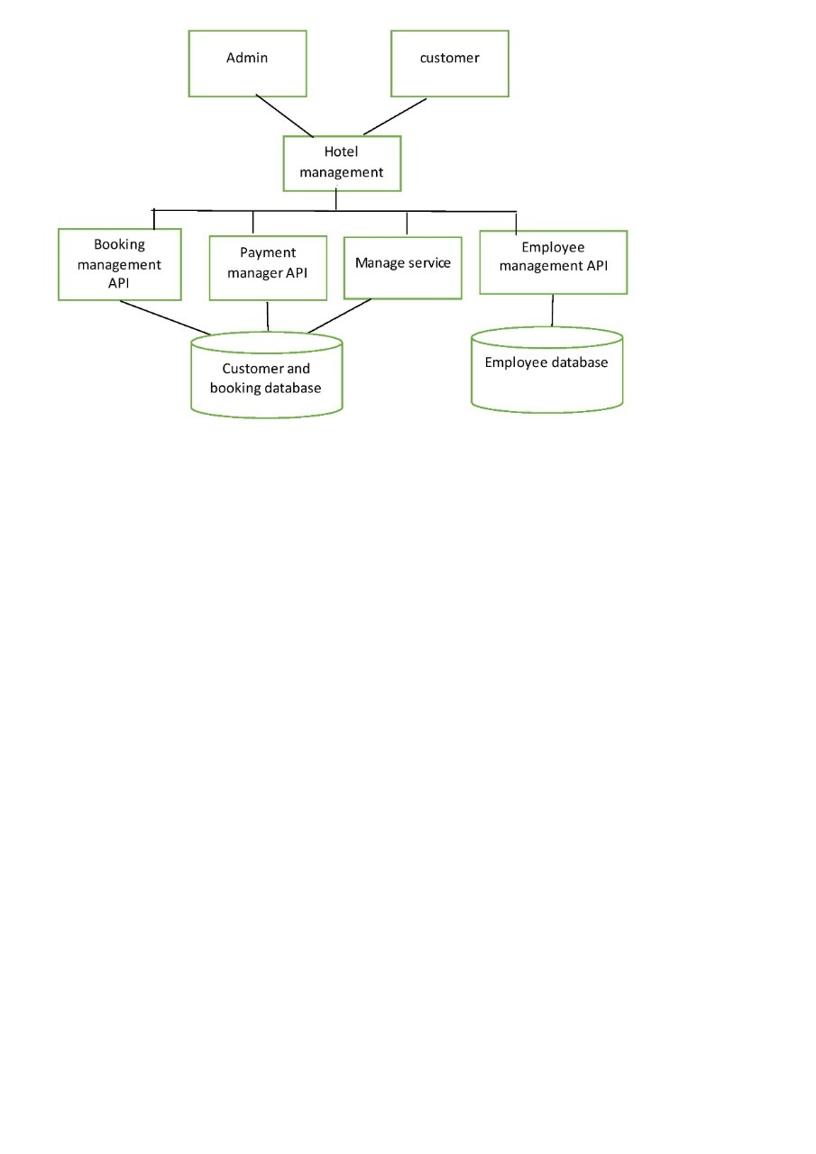
Architecture Diagram

Slide 6
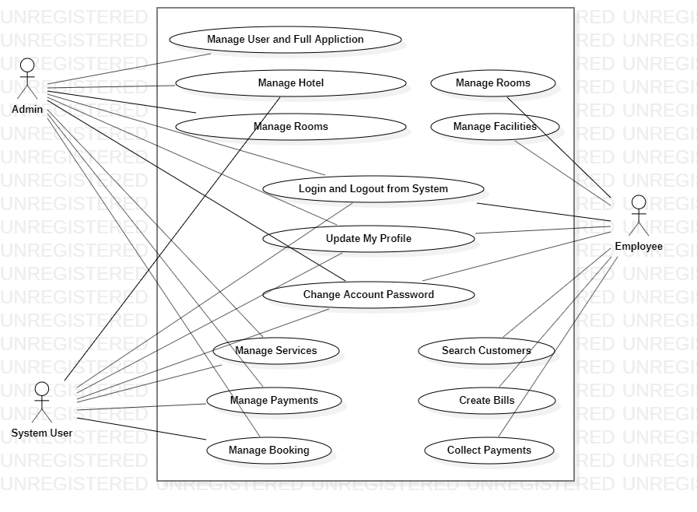
Use Case Diagram

Slide 7
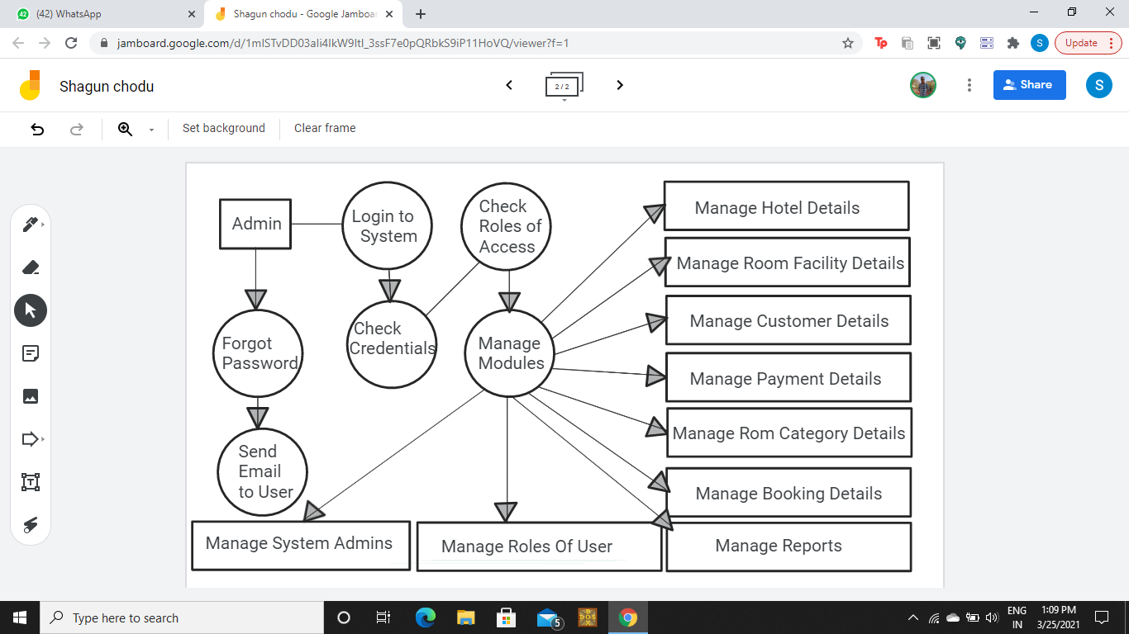
DFD Diagram

Slide 8
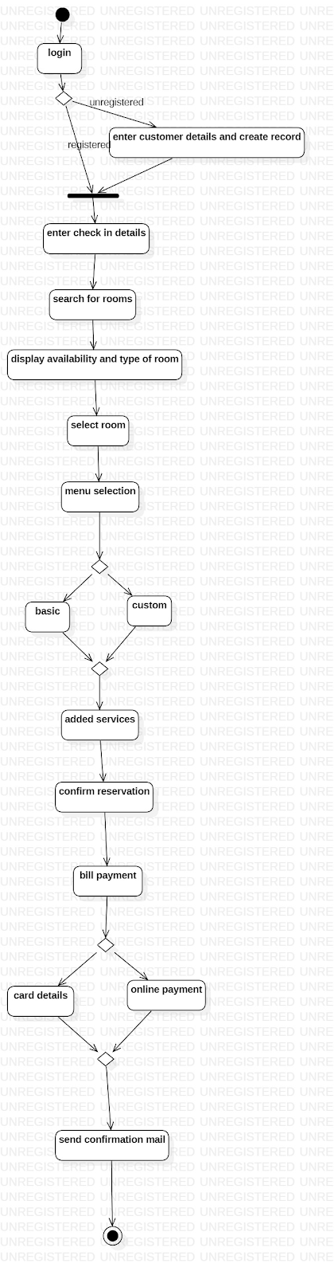
Activity Diagram

Slide 10
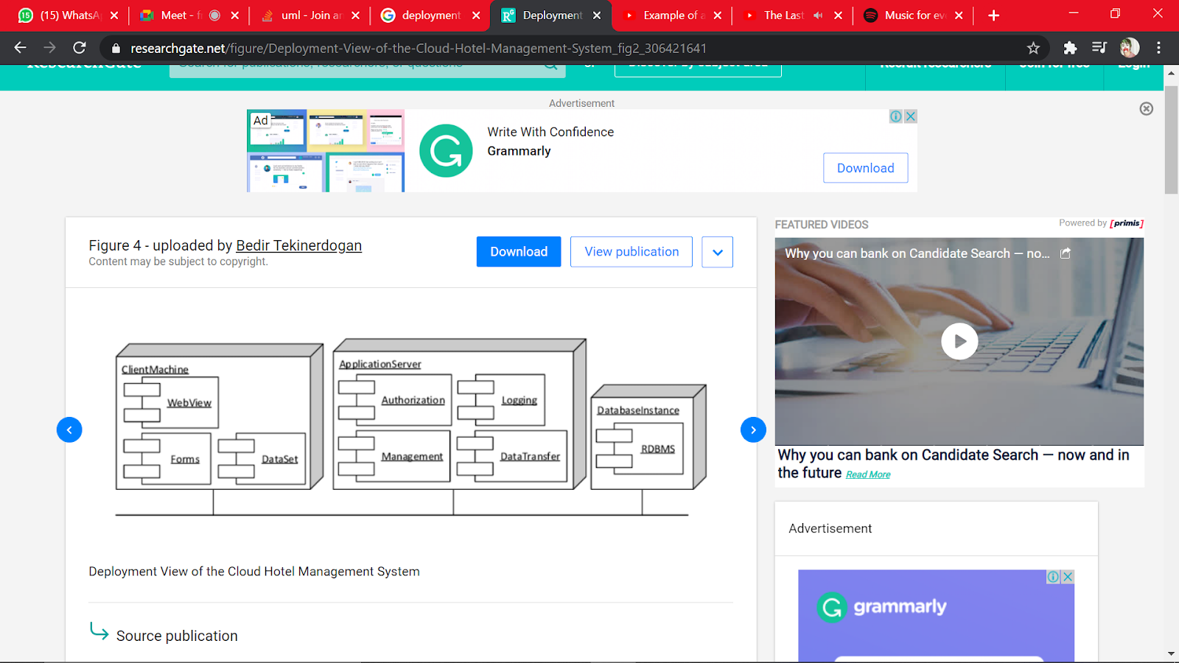
Deployment Diagram

Slide 11

Sample UI/UX Design

Slide 12
Module Implementation

Slide 13
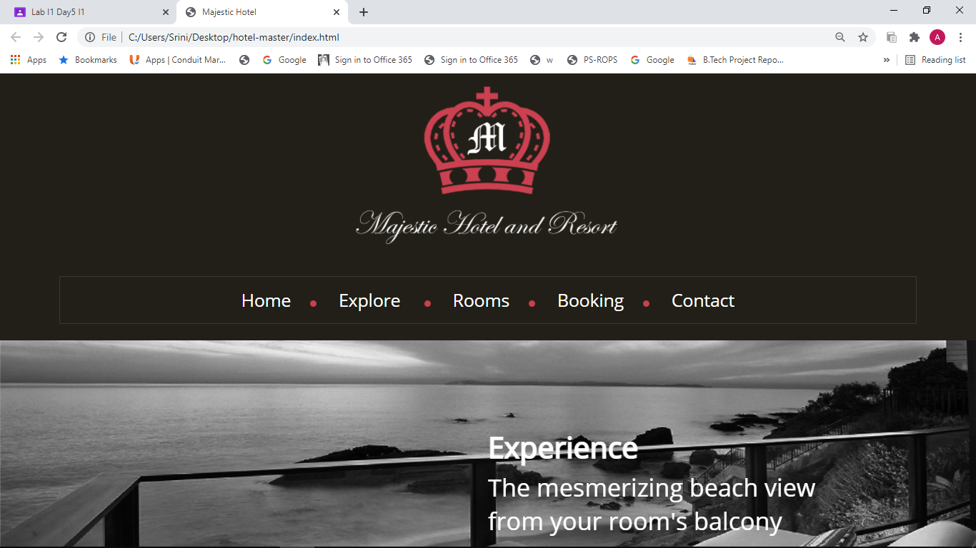
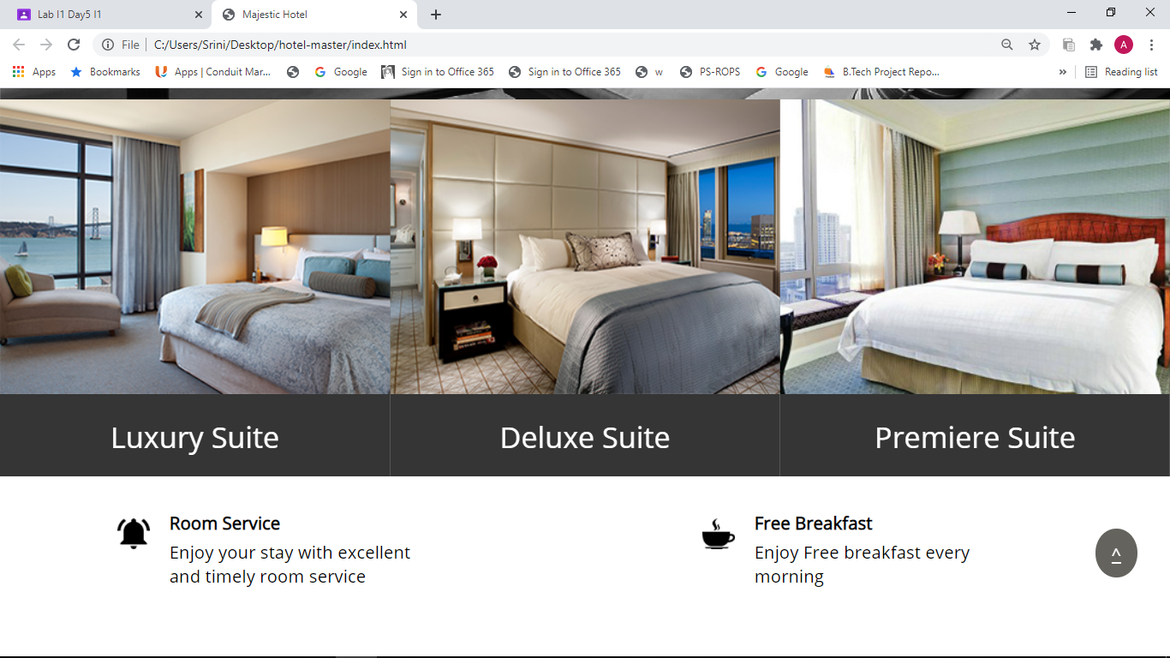
MODULE 1: HOMEPAGE

Slide 14
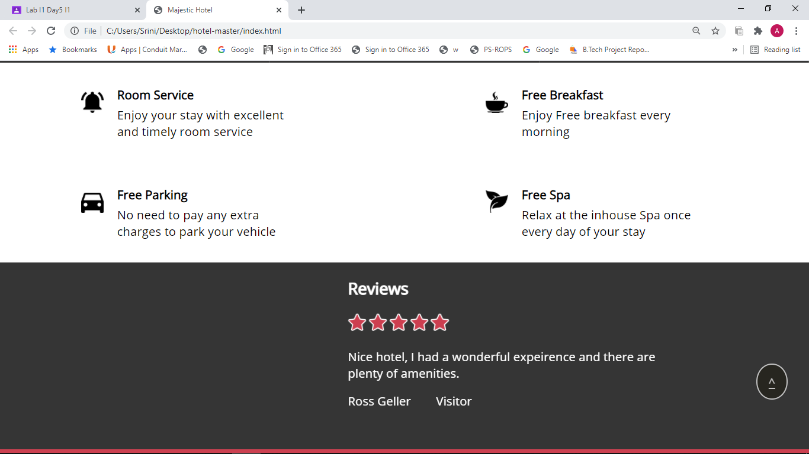
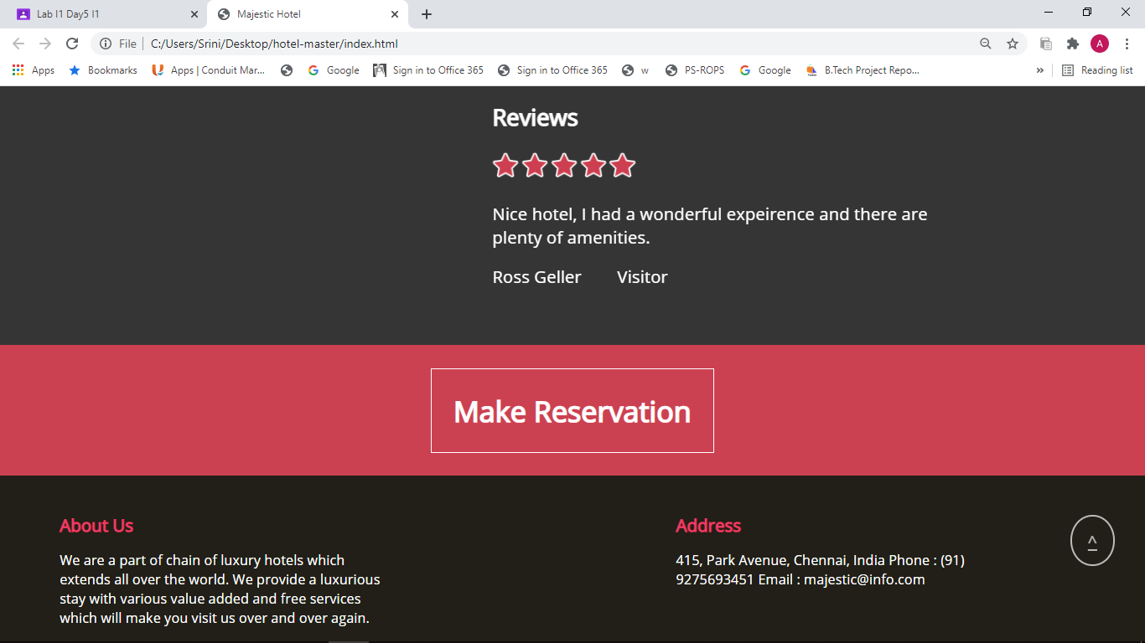

Slide 15
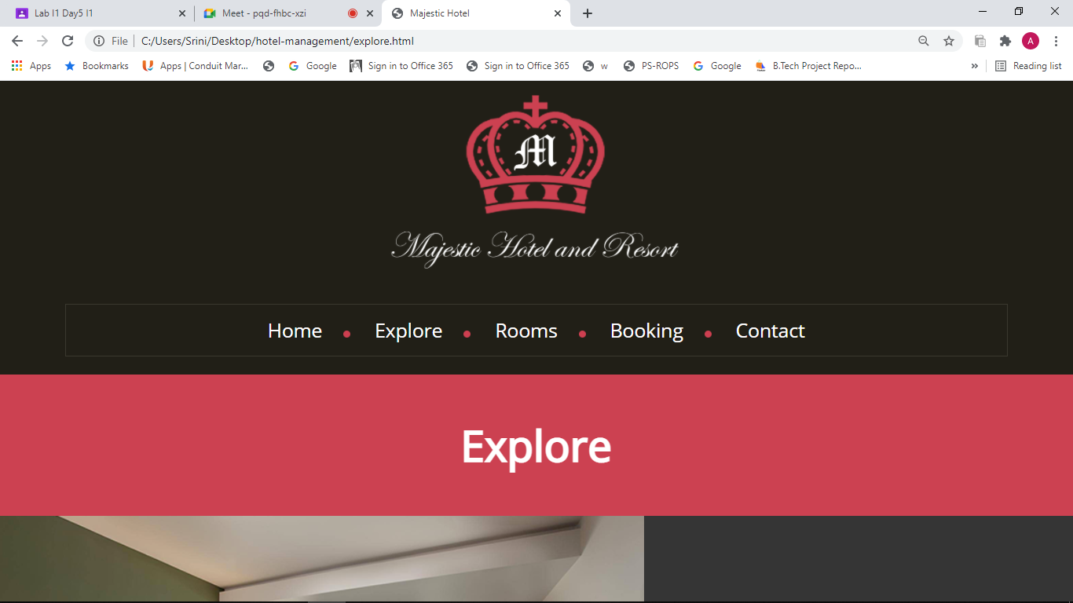
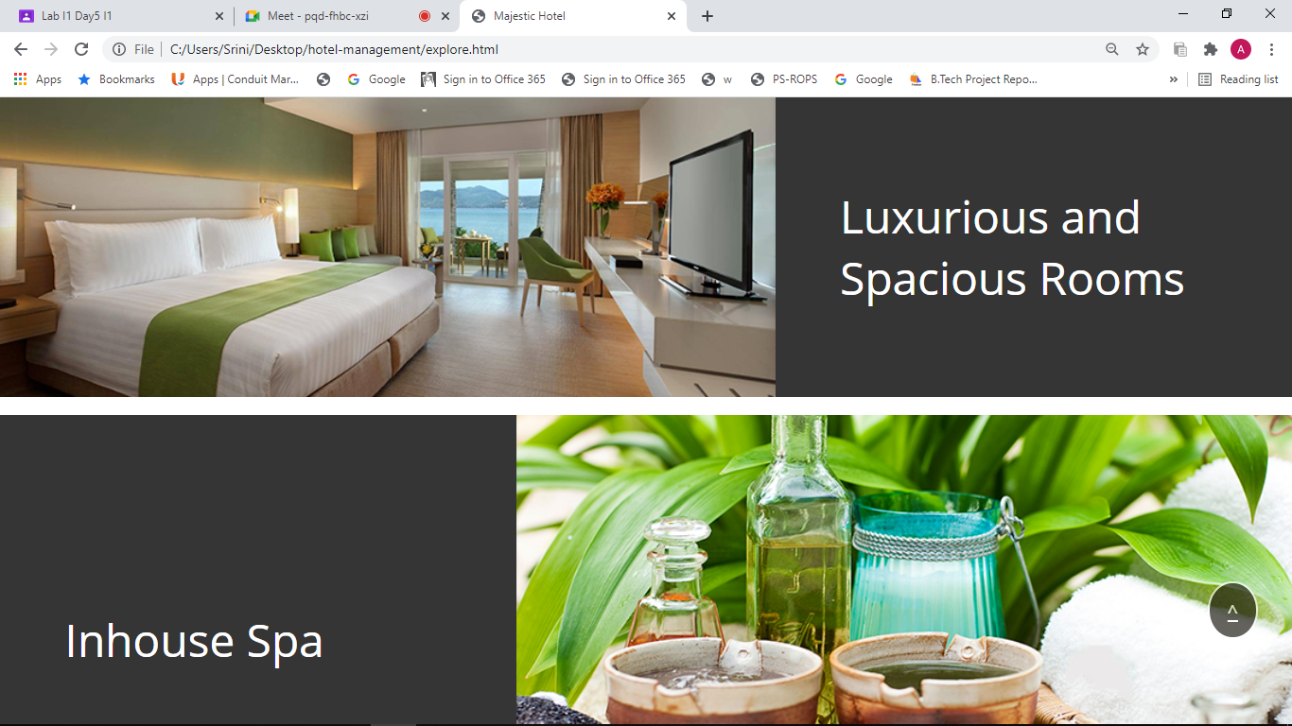
MODULE 2 : EXPLORE PAGE

Slide 16
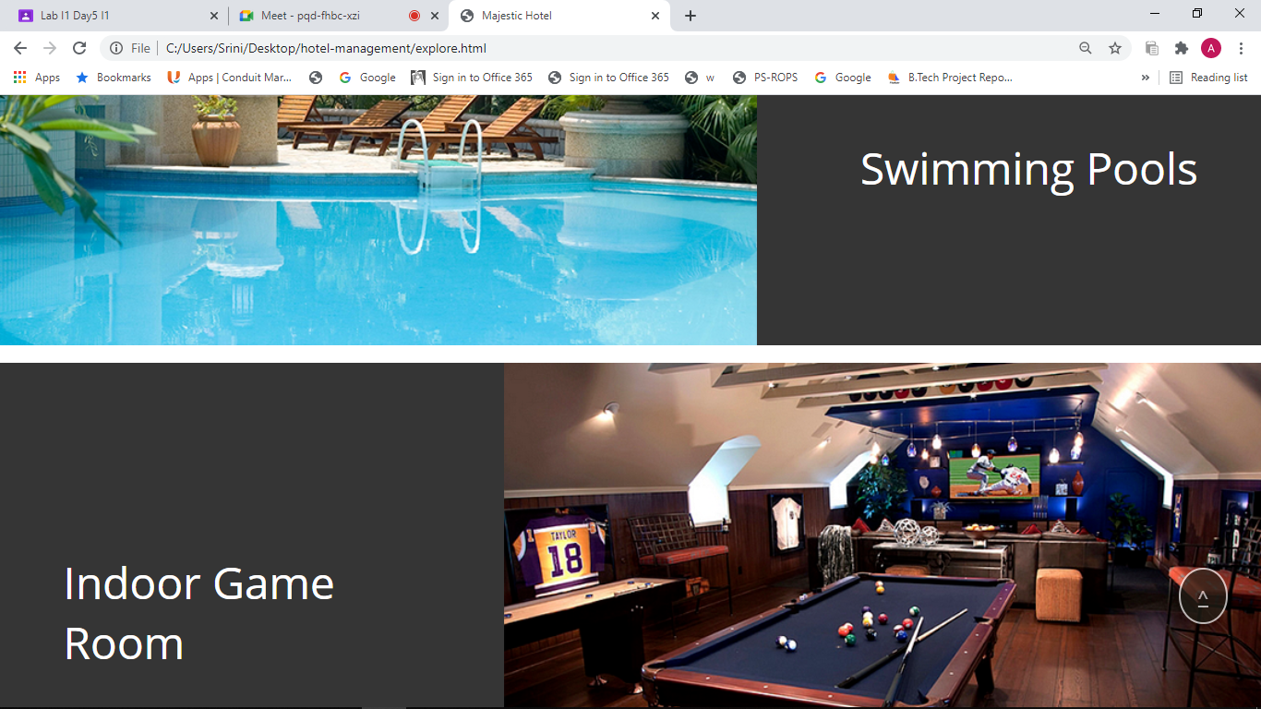
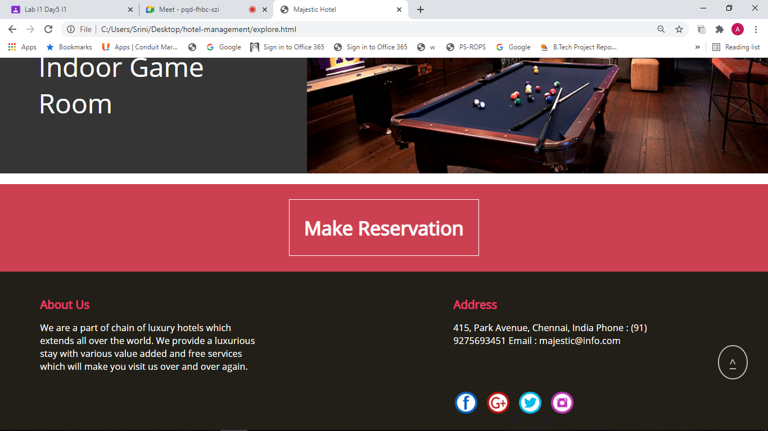

Slide 17
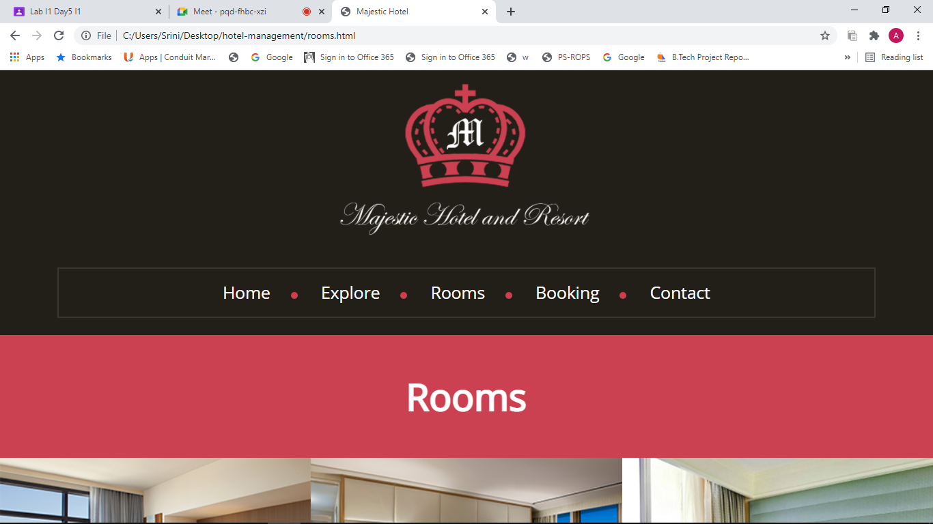
MODULE 2 : ROOMS PAGE

Slide 18
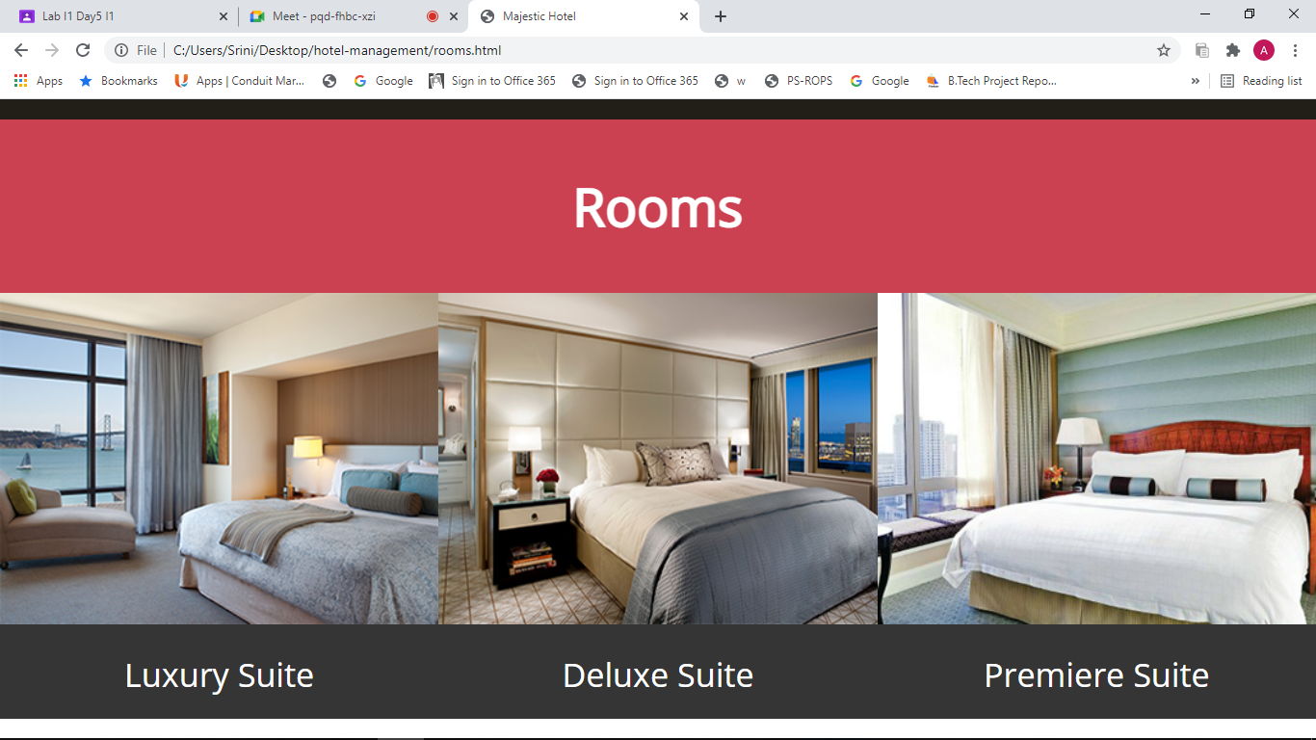
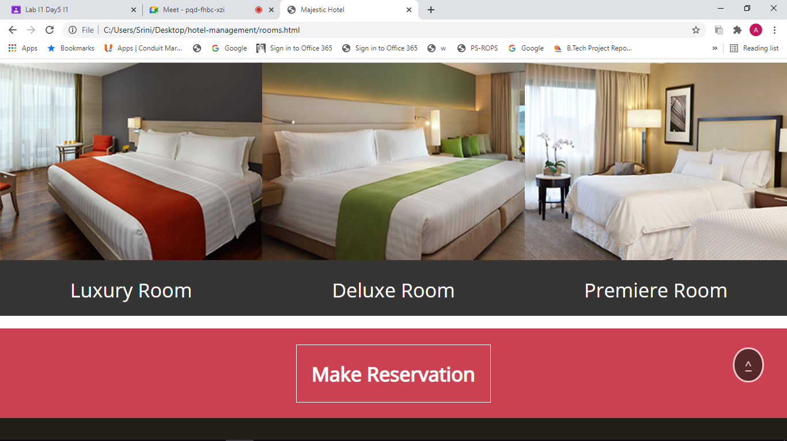

Slide 19
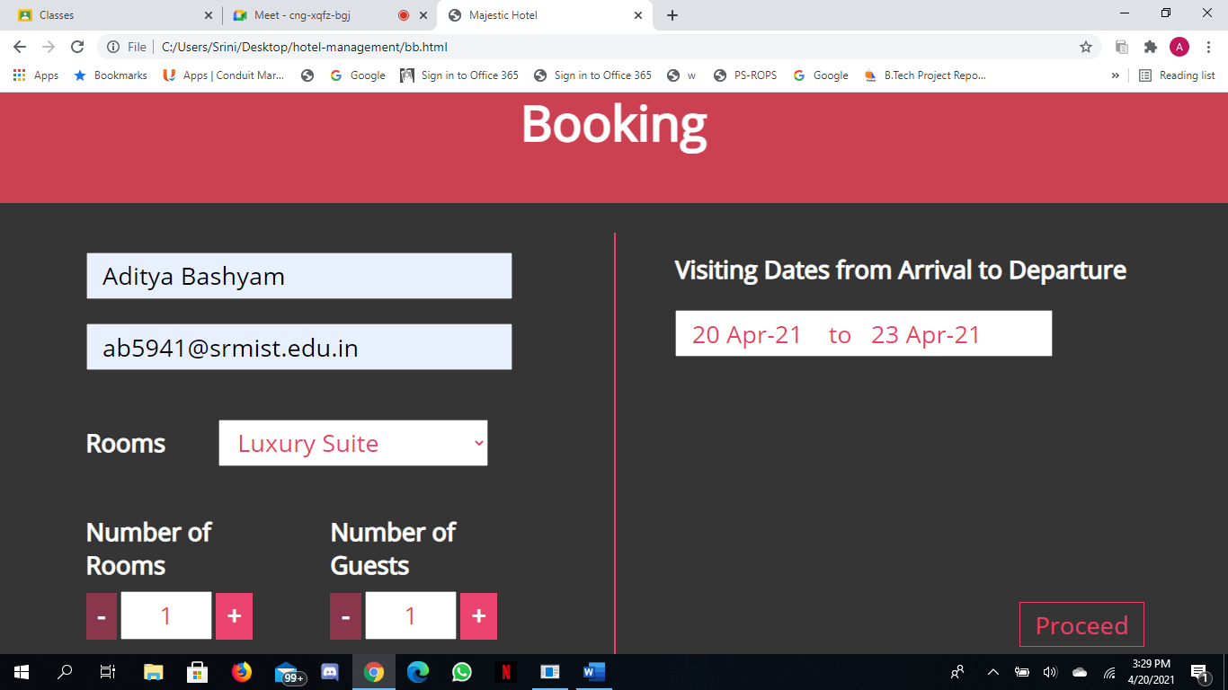
MODULE 3 : BOOKING PAGE

Slide 20
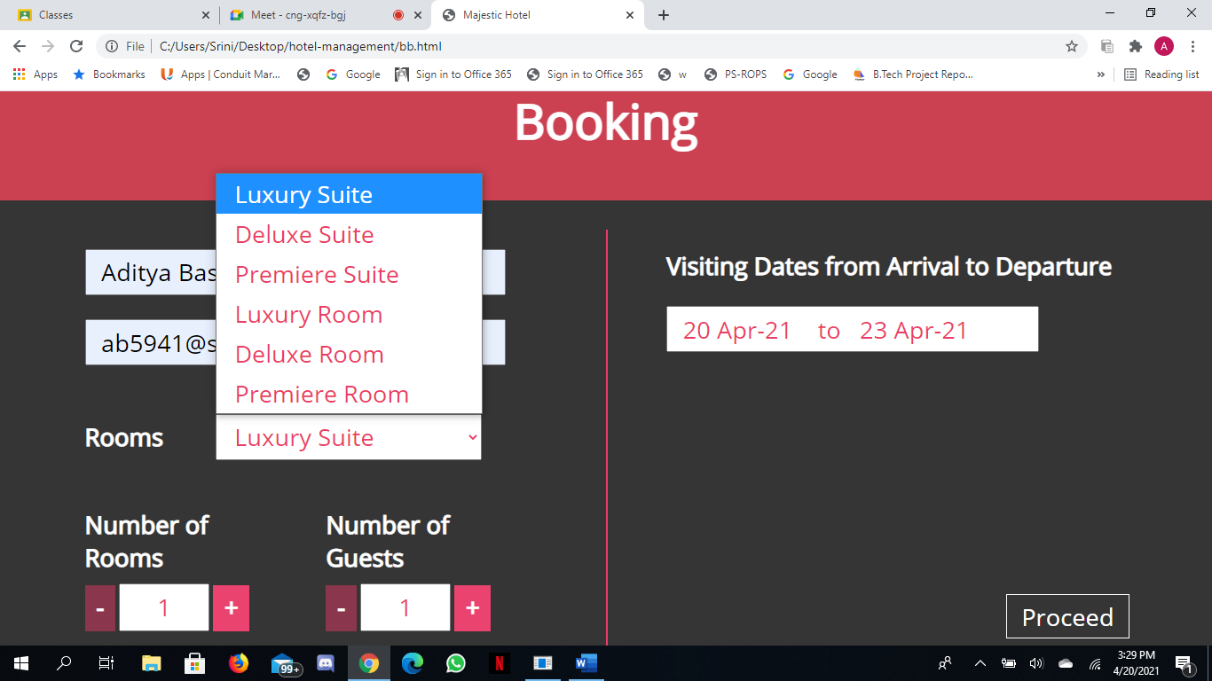
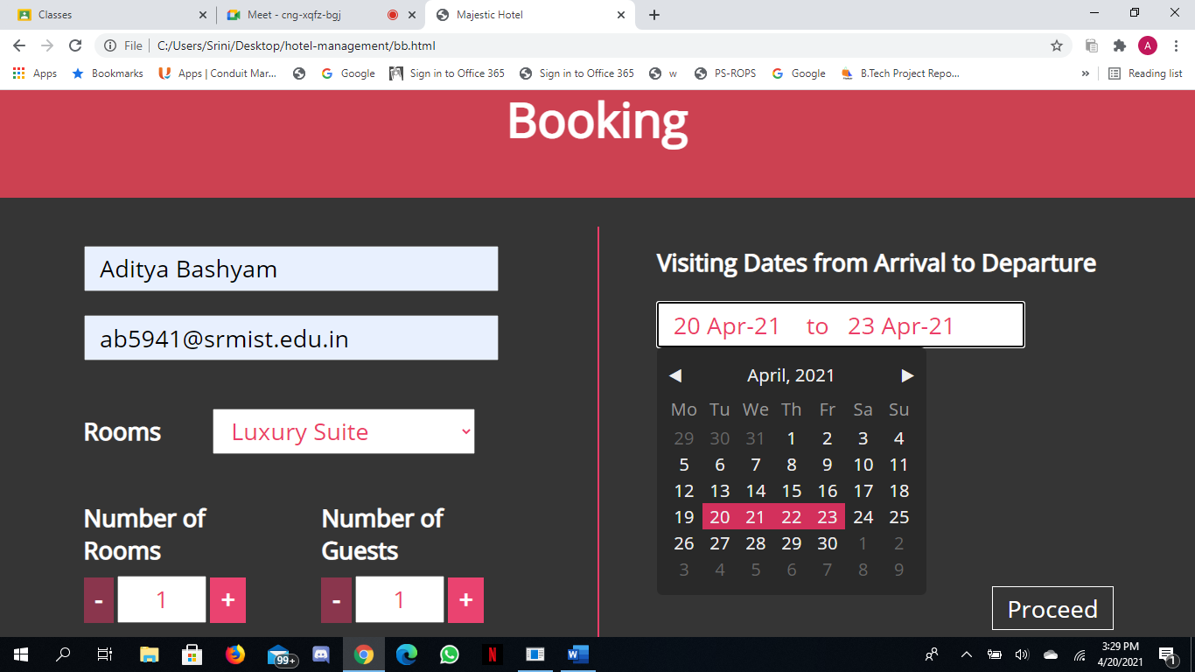

Slide 21
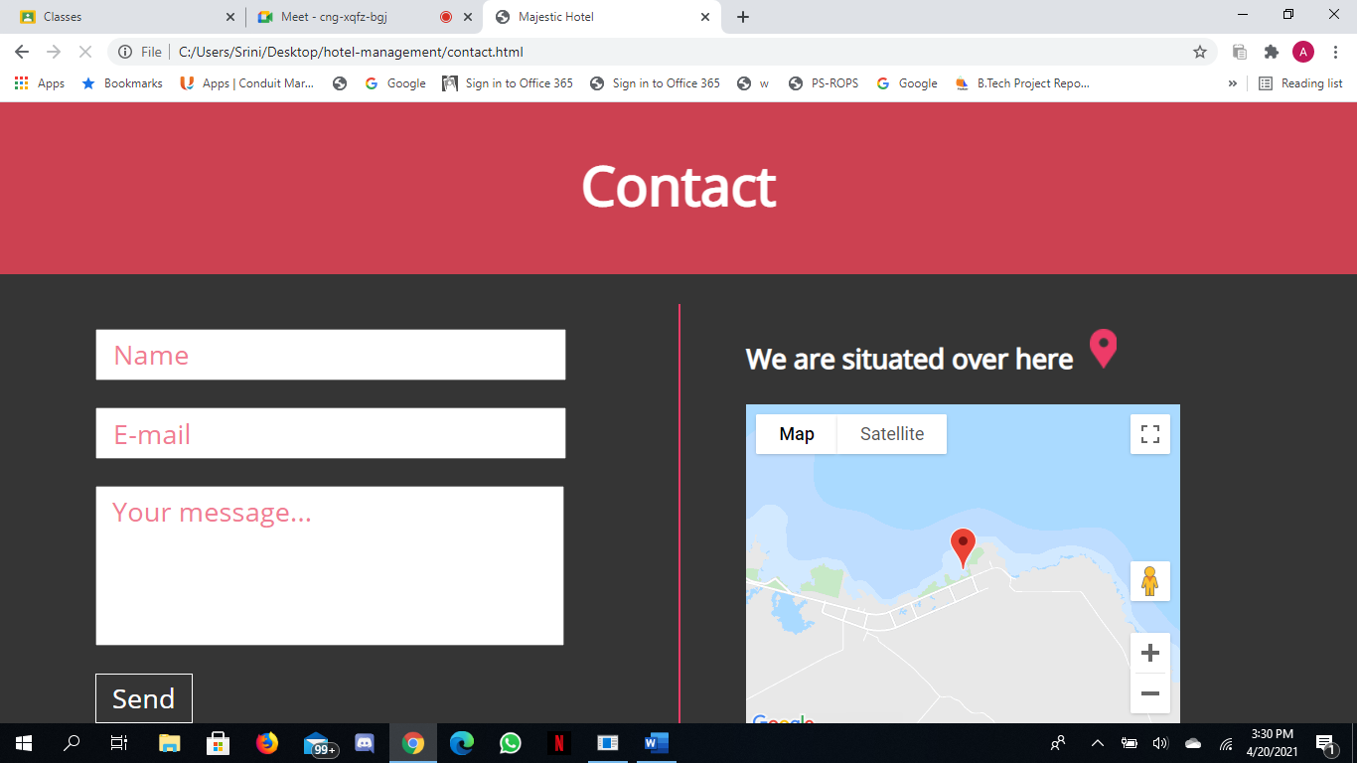
MODULE 3 : CONTACT PAGE

Slide 22
Test Cases

Slide 23
FUNCTIONAL TEST CASES
Test ID (#) | Test Scenario | Test Case | Execution Steps | Expected Outcome | Actual Outcome | Status | Remarks
T1 | User getting the home screen | Home Screen is visible or not | Home Screen is directly visible to the user | Home Screen is visible | Home screen | Pass | Success
T2 | User directly can see the booking page | Booking Page is visible or not | By pressing the Make Reservation button, it directly goes to the booking page | Booking screen is visible | Booking screen | Pass | Success

Slide 24
T3 | User getting the explore page | Explore Page is visible or not | Explore Screen is directly visible | Explore Screen is visible | Explore Screen | Pass | Success
T4 | User directly can see the booking page | Booking Page is visible or not | By pressing the Make Reservation button, it directly goes to the booking page | Booking Screen is visible | Booking Screen | Pass | Success
T5 | User getting the rooms page | Rooms page is visible or not | Rooms Screen is directly visible | Rooms screen is visible | Rooms screen | Pass | Success
T6 | User directly can see the booking page | Booking Page is visible or not | By pressing the Make Reservation button, it directly goes to the booking page | Booking Screen is visible | Booking Screen | Pass | Success

Slide 25
T7 | User entering details in the booking page | Details entered are valid | Enter the details in the booking page and press Proceed | Confirmation page is visible | Confirmation Page | Pass | Success
T8 | User entering details in the booking page | Details entered are invalid | Enter the details in the booking page | invalid details is visible | invalid details | Pass | Success
T9 | User entering details in the booking page | User entering wrong email id | Enter the details in the booking page | invalid details is visible | invalid details | Pass | Success
T10 | User entering details in the booking page | User entering wrong name | Enter the details in the booking page | invalid details is visible | invalid details | Pass | Success

Slide 26
T11 | User entering details in the contact page | Details entered are valid | Enter the details in the contact page | Thank you Page is visible | Thank you page | Pass | Success
T12 | User entering details in the contact page | Details entered are invalid | Enter the details in the contact page | invalid details is visible | invalid details | Pass | Success

Slide 27
NON- FUNCTIONAL TEST CASES
Test ID (#) | Test Scenario | Test Case | Execution Steps | Expected Outcome | Actual Outcome | Status | Remarks
T1 | Opening the website for first time | Home page | Home Screen is directly visible | Opening within 2-3 sec | 2 sec | Pass | Success
T2 | Toggling b/w home screen and other pages | Toggling screens | Moving to different screens | Seamless movement | Seamless movement | Pass | Success
T3 | The Website should be responsive | The frontend of the web application should be responsive | The website is opened directly | The Website showing response | The Website is Responsive | Pass | Success

Slide 28
Thank you

